Slide 1
Biotechnology -Gene and Cell Replacement Therapy

Slide 2
What are we doing today?
Gene therapy can be used to treat a range of diseases, including diabetes mellitus (SHE)
Cell replacement therapy has the potential to treat nervous system disorders including Alzheimer’s and Parkinson’s diseases (SHE)

Slide 3

Gene Therapy
Gene therapy is when DNA is introduced into a patient to treat a genetic disease. The new DNA usually contains a functioning gene to correct the effects of a disease-causing mutation.
Gene therapy uses sections of DNA (usually genes) to treat or prevent disease.
The DNA is carefully selected to correct the effect of a mutated gene that is causing disease.
The technique was first developed in 1972 but has, so far, had limited success in treating human diseases

Slide 4
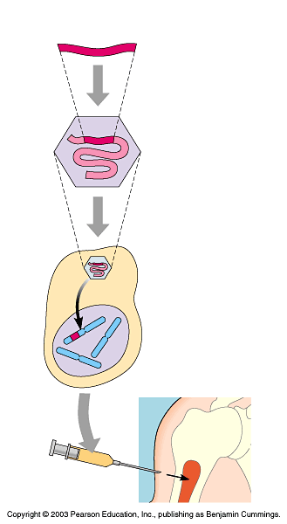
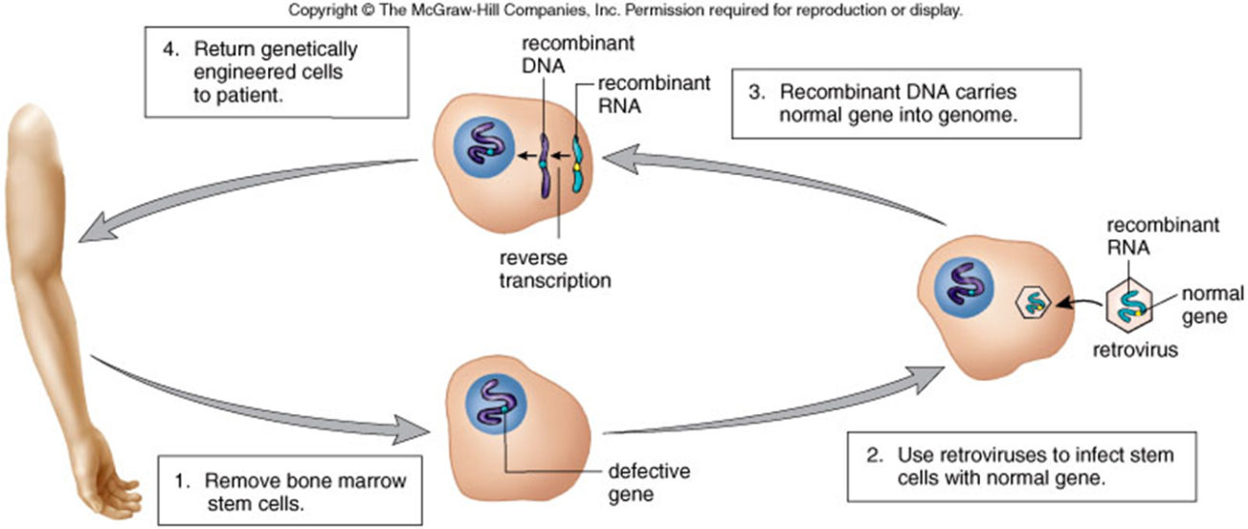
How does it work?
Cloned gene (normal allele)
Somatic gene therapy: transfer of a section of DNA to any cell of the body that doesn’t produce sperm or eggs. Effects of gene therapy will not be passed onto the patient’s children.
Germline gene therapy: transfer of a section of DNA to cells that produce eggs or sperm. Effects of gene therapy will be passed onto the patient’s children and subsequent generations.
1
Insert normal gene into virus
Viral nucleic acid
Retrovirus
2
Infect bone marrow cell with virus
3
Viral DNA inserts into chromosome
Bone marrow cell from patient
Bone
marrow
4
Inject cells into patient

Slide 5
Gene therapy challenges
Delivering the gene to the right place and switching it on:
it is crucial that the new gene reaches the right cell
delivering a gene into the wrong cell would be inefficient and could also cause health problems for the patient
once the right cell has been targeted the gene has to be turned on
cells sometimes obstruct this process by shutting down genes that are showing unusual activity.
Avoiding the immune response:
The role of the immune system is to fight off intruders.
Sometimes new genes introduced by gene therapy are considered potentially-harmful intruders.
This can spark an immune response in the patient that could be harmful to them.
Scientists therefore have the challenge of finding a way to deliver genes without the immune system ‘noticing’.
This is usually by using vectors that are less likely to trigger an immune response.
Making sure the new gene doesn’t disrupt the function of other genes:
Ideally, a new gene introduced by gene therapy will integrate itself into the genome of the patient and continue working for the rest of their lives.
There is a risk that the new gene will insert itself into the path of another gene, disrupting its activity.
This could have damaging effects, for example, if it interferes with an important gene involved in regulating cell division, it could result in cancer.
The cost of gene therapy:
Many genetic disorders that can be targeted with gene therapy are extremely rare.
Gene therapy therefore often requires an individual, case-by-case approach. This may be effective, but may also be very expensive.

Slide 6
What could we use this for?
Cystic Fibrosis
Have successfully corrected faulty gene in cultured cells
Trials for methods of gene transfer into patients are occurring.
Have not been able to replace enough genes for any long lasting benefit in patient.
Huntington’s Disease
Have conducted successful research with mice.
Have also been able to transfer genes in rats and primates which is encouraging human trials.

Slide 7
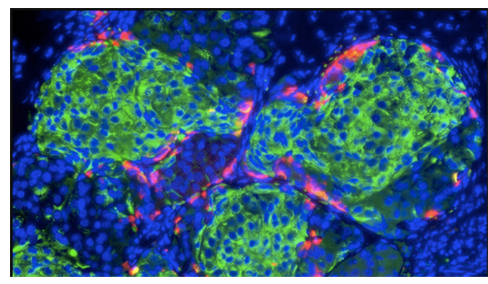
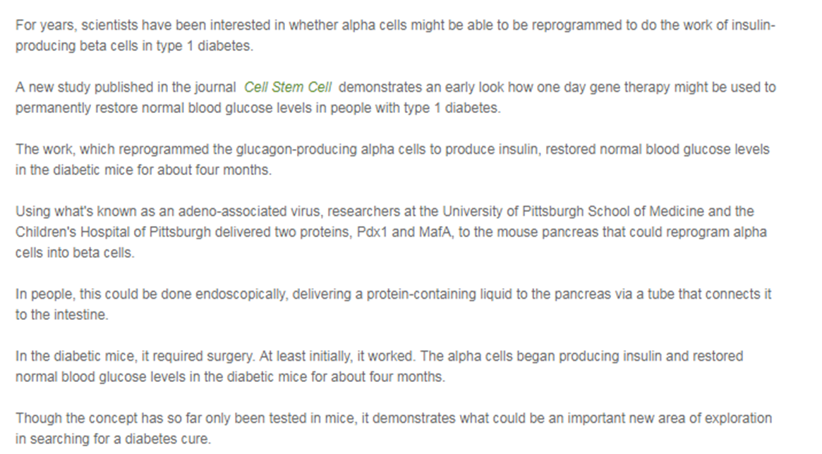
Treating Diabetes
Notes:
https://www.diabetesqld.org.au/media-centre/2018/january/could-gene-therapy-one-day-cure-type-1-diabetes.aspx
https://www.medicalnewstoday.com/articles/317343.php

Slide 8
Cell replacement therapy
When normal cells are lost or injured, stem cells (undifferentiated cells) could be used to;
Regenerate
Identify the cues that allow for regeneration without scarring
Like growing a new limb
Repair
Stimulate the tissue at a cell or molecular level, even at level of DNA, to repair itself.
Replace
A biological substitute is created in the lab that can be implanted to replace the tissue or organ of interest

Slide 9
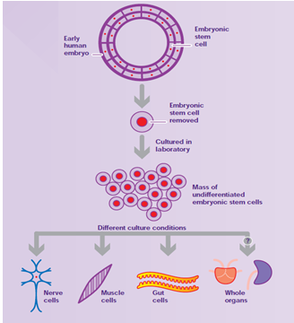
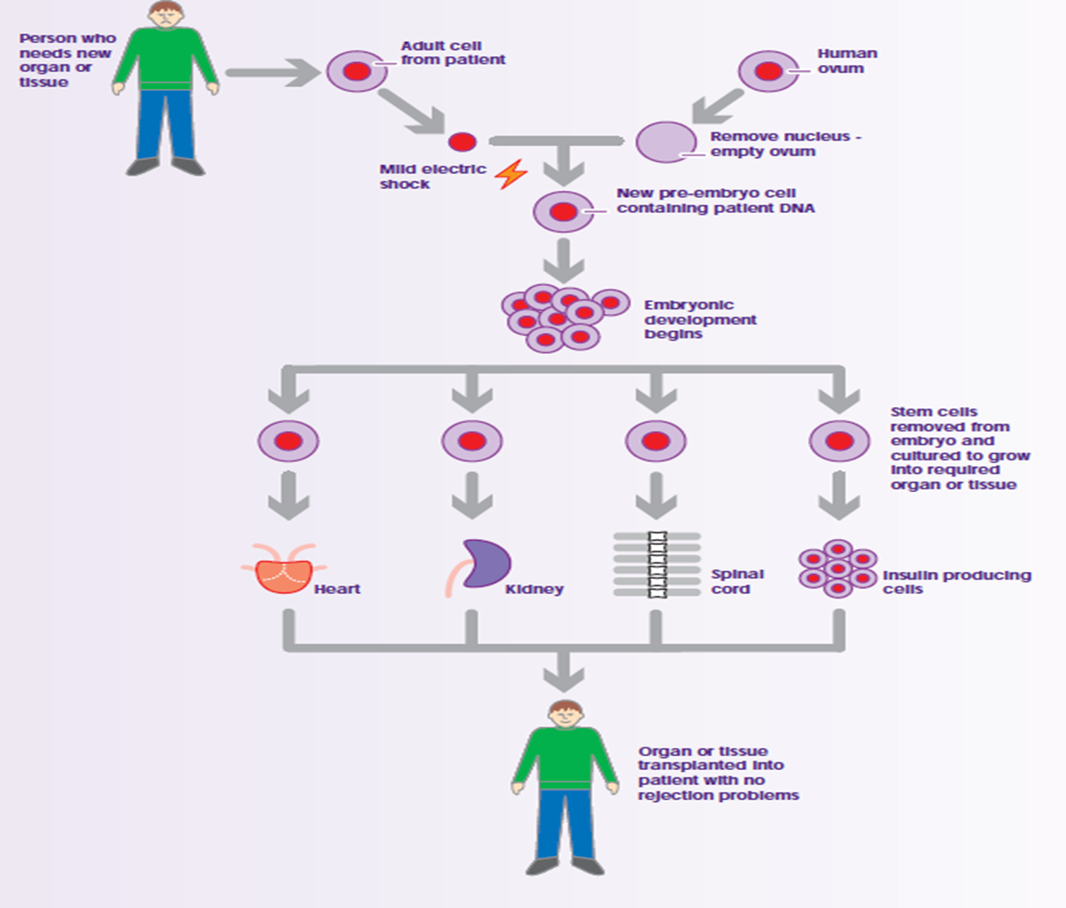
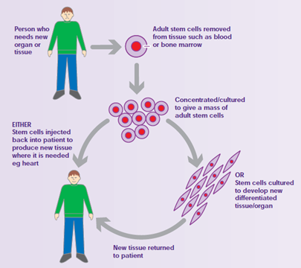
Cell replacement therapy

Slide 10
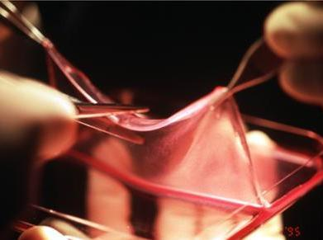
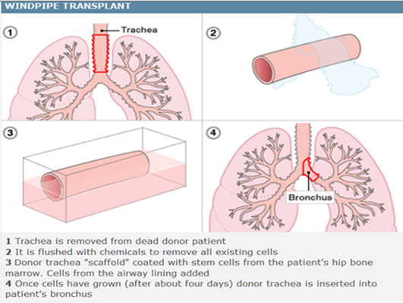
Tissue Engineering
Using well designed scaffolds and optimized cell growth, we can create tissues such as:
Skin
Bone
Cartilage
Intestine
These have been successfully engineered to some extent

Slide 11
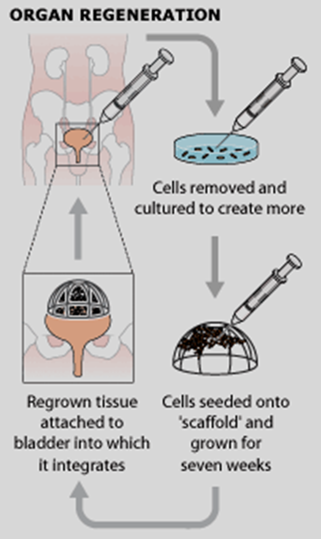
Transplants
Remove cells from patient
Grow in culture with or without biomaterials
Give appropriate chemicals to make cells do what is needed
Replace into patient

Slide 12
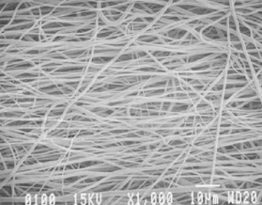
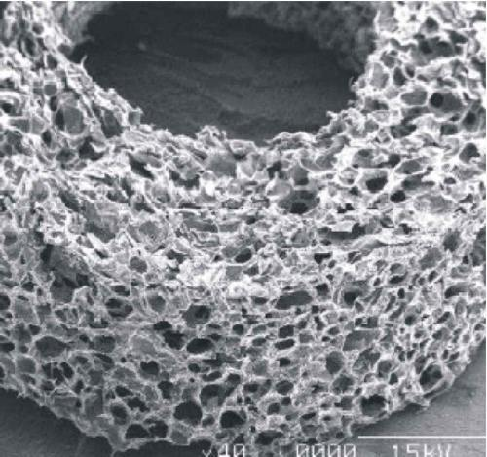
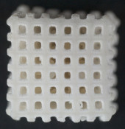
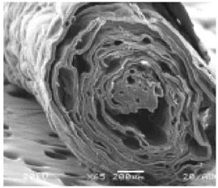
Scaffolds
Various textures and materials
Encourage cells to grow
Allow nutrients to permeate
Biodegradable-Won’t harm the patient

Slide 13
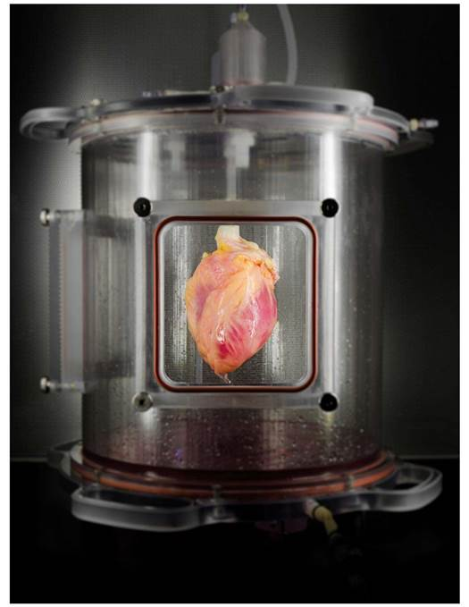
In the future..
Not very far in development
Complex metabolic functions
Require multiple types of cells and intricate scaffolds
Liver
Heart
Lung
Kidney
https://www.popsci.com.au/science/medicine/scientists-grow-fullsized-working-human-hearts-from-stem-cells,417050

Slide 14
What could we use this for?
Type I diabetes transplant of new pancreas cells
Adult stem cells for heart disease
Neuronal transplants for Parkinson’s disease
Bone marrow transplant for various blood cancers
Muscular dystrophy and polio
*Research how cell replacement therapy can applied to each of those mentioned above.

Slide 15
Exam Question
There are many diseases that affect the ability to breathe normally. One of these is cystic fibrosis. This is a genetic disease, one symptom of which is excess mucous in the lungs that causes breathing difficulties. Recently there has been much discussion and trialling of treatments involving gene therapy and cell replacement therapy for cystic fibrosis. A combined gene and cell replacement therapy strategy for treatment is also being explored.
How could gene therapy and cell replacement therapy be combined as a treatment? (4 marks)

Slide 16
Answer
Stem cells taken from the patient
Faulty gene replaced by normal gene
Healthy cells cultured/multiplied
Healthy cells transplanted back into patient

